Slide 1
MARKETING
Marketing as defined as "the total of activities involved in the transfer of goods from the producer or seller to the consumer or buyer, including advertising, shipping, storing, and selling."

Slide 2
Thus Marketing can be categorized as a branch of business as well as a social science. We buy goods (thus becoming the buyer/consumer) from a vendor (or producer/seller), creating a transaction.
In the past, marketing involved traveling salesmen, while in modern times, marketing is more likely to involve television, the internet, and other forms of media bombardment.

Slide 3
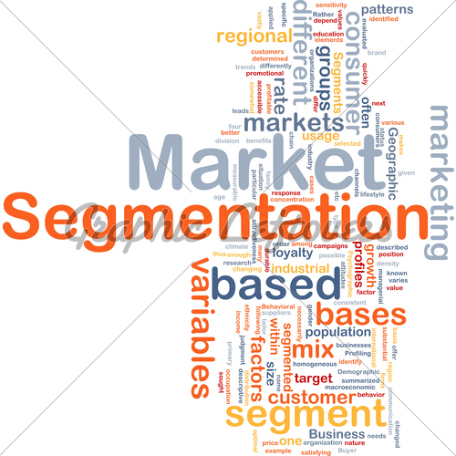

Slide 5
Market segmentation is a marketing strategy that involves dividing a broad target market into subsets of consumers who have common needs and priorities, and then designing and implementing strategies to target them.
Market segmentation strategies may be used to identify the target customers, and provide supporting data for positioning to achieve a marketing plan objective.
Businesses may develop product differentiation strategies, or an undifferentiated approach, involving specific products or product lines depending on the specific demand and attributes of the target segment.

Slide 6
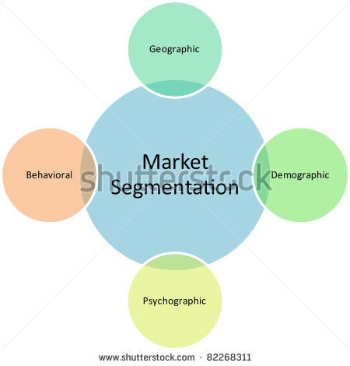

Slide 7
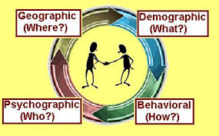

Slide 9
Geographic Segmentation
Marketers can segment according to geographic criteria—nations, states, regions, countries, languages, cities, neighborhoods, or postal codes. The geo-cluster approach combines demography.
With respect to region, in rainy regions merchants can sell things like raincoats, umbrellas and gumboots. In hot regions, one can sell summer clothing. A small business commodity store may target only customers from the local neighborhood, while a larger department store can target its marketing towards several neighborhoods in a larger city or area, while ignoring customers in other continents.
Geographic Segmentation is important and may be considered the first step to international marketing, followed by demographic and psychographic segmentation.
The use of national boarders is the institutional use of geographic segmentation, although geographic segments may be classified by identified geological regions.

Slide 10
Demographic Segmentation
Demographic segmentation is dividing markets into different groups according to their age, gender, the amount of income, the ethnicity or religion of the market and the family life cycle.

Slide 11
Behavioral Segmentation
Behavioral segmentation divides consumers into groups according to their knowledge of, attitude towards, usage rate or response to a product.
There is an extra connectivity with all other market related sources.

Slide 12
Psychographic Segmentation
Psychographic segmentation, which is sometimes called Lifestyle. This is measured by studying the activities, interests, and opinions (AIOs) of customers. It considers how people spend their leisure, and which external influences they are most responsive to and influenced by. Psychographic is highly important to segmentation, because it identifies the personal activities and targeted lifestyle the target subject endures, or the image they are attempting to project.
Mass Media has a predominant influence and effect on Psychographic segmentation. Lifestyle products may pertain to high involvement products and purchase decisions, to speciality or luxury products and purchase decisions. Lifestyle segmentation reflects on how the target subject identifies themselves, or how they desire to identify themselves in society. By identifying and understanding consumer lifestyle, businesses can develop promotional mixes and product lines, which tailor to their needs.
Segmentation according to occasions relies on the special needs and desires of consumers on various occasions - for example, for products for use in relation with a certain holiday. Products such as decorations or lamps are marketed almost exclusively in the time leading up to the related event, and will not generally be available all year round. Another type of occasional market segments are people preparing for a wedding or a funeral, occasions which only occur a few times in a person's lifetime, but which happen so often in a large population that ongoing general demand makes for a worthwhile market segment

Slide 13
Segmentation by benefits
Segmentation can take place according to benefits sought by the consumer.

Slide 14
Segmentation by Demography
Segmentation according to demography is based on variables such as age, gender, occupation and education level or according to perceived benefits which a product/service may provide

